Slide 1
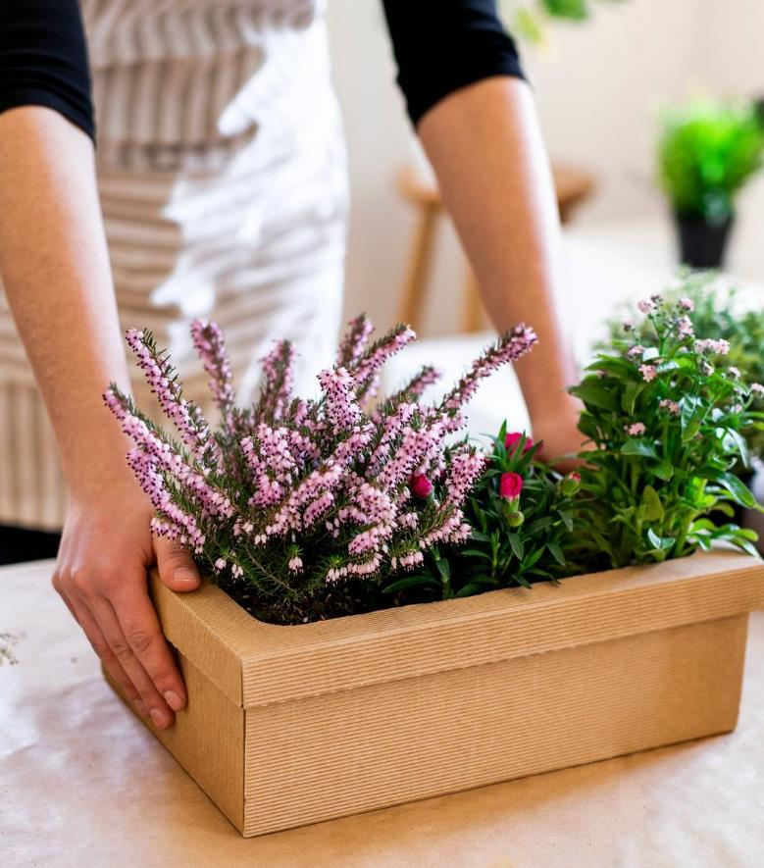
FLORA GENIE
Team Name: Inception
Swadi Korattiparambil MT2023144
Riya Patidar MT2023117
Srishti Yadav MT2023125
Anjali J Kumar MT2023126
Under the guidance of
Prof. Raghuram Bharadwaj

Slide 2
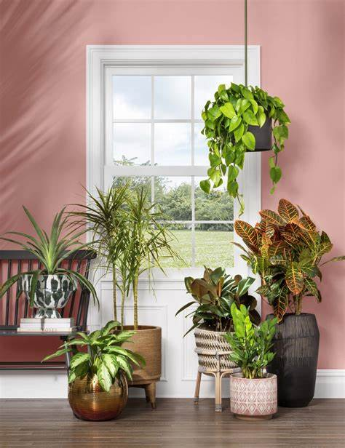
Introduction
Flora Genie is a personalized plant recommendation system aimed at assisting amateur gardening enthusiasts in selecting the most suitable plants for their home or garden.
By specifying criteria such as plant category, light and water requirements, plant form, foliage description, and more, users can receive tailored recommendations.

Slide 3
Workflow
Data Extraction
Extracted comprehensive plant data and images, encompassing a wide range of species, including medicinal plants, to build a rich dataset for analysis.
Preprocessing and EDA
Transformed categorical columns into one-hot encoding for efficient processing.
Algorithm Analysis
Explored a range of clustering algorithms to identify the most effective methods for grouping plants based on their attributes. Additionally, conducted textual similarity analysis using TF-IDF.
Similarity Metrics
Employed a few variety of similarity metrics to measure the likeness between user vectors and plant data, facilitating accurate plant recommendations tailored to individual preferences.
Recommendations
Provided personalized plant recommendations by leveraging advanced algorithms and similarity metrics, enabling users to discover the ideal plants for their specific needs and preferences.

Slide 4
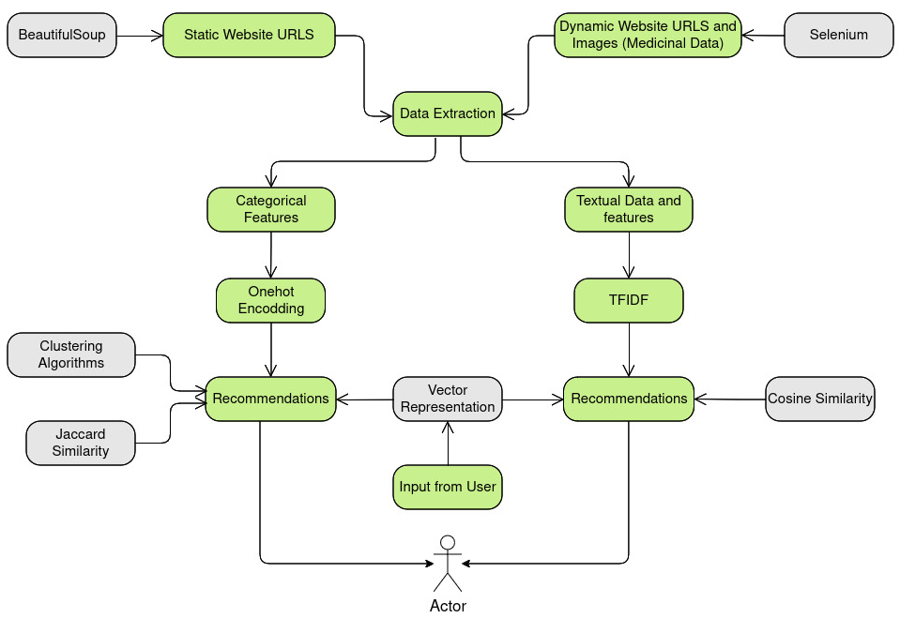
Pipeline

Slide 5
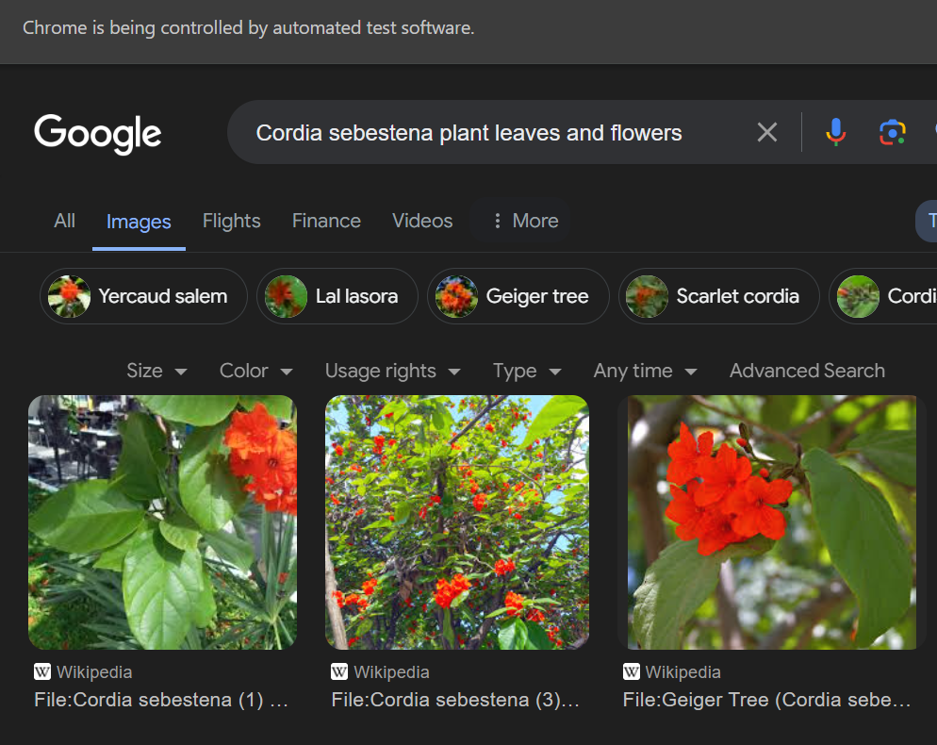
Data Extraction
Given the unavailability of preprocessed plant data tailored to India, we compiled our own plant dataset, sourcing data from diverse online platforms.
This comprehensive dataset combines information from multiple sources, including medicinal plant uses, to enrich our recommendation system.
In addition to textual data, we extracted plant images to provide users with visual insights into each plant, enhancing their browsing experience.

Slide 6
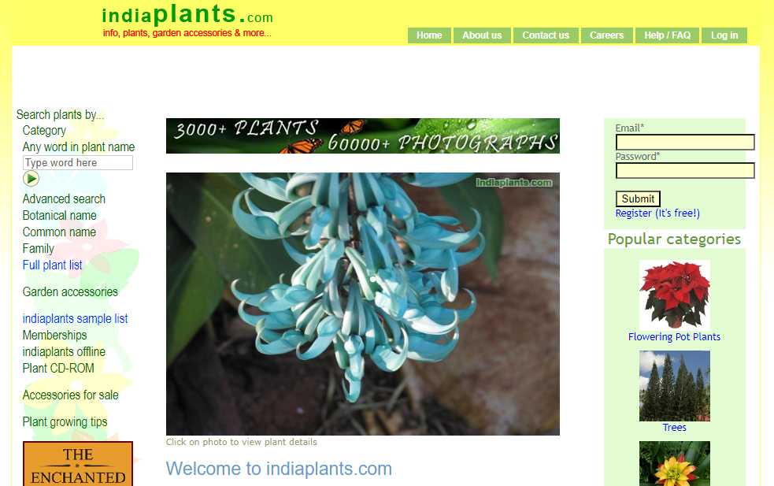
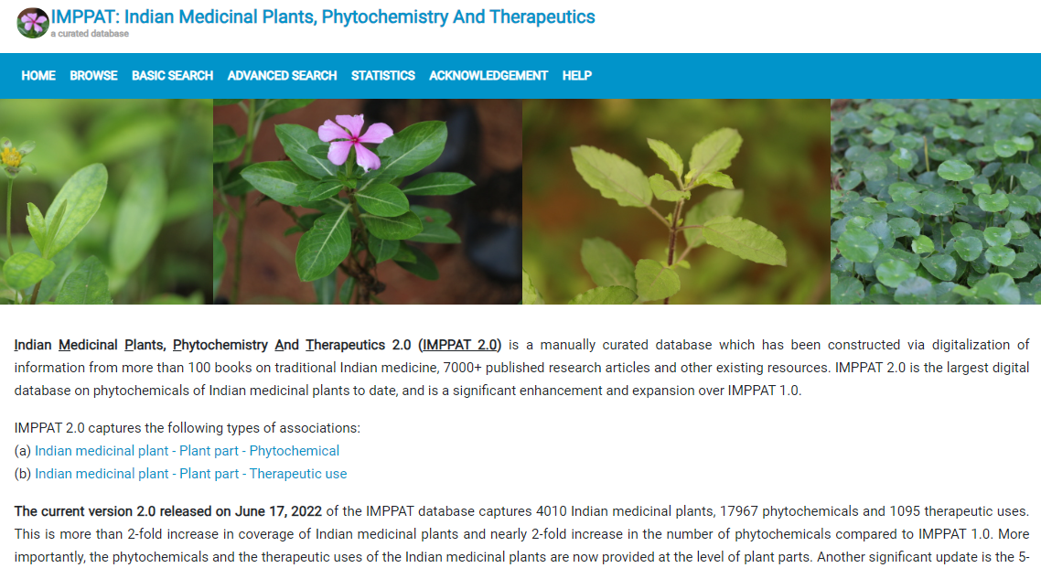
Extraction Details
Websites used for extracting plant information:
India Flora Online
India Plants
IMPPAT: Indian Medicinal Plants, Phytochemistry And Therapeutics
Images were extracted from multiple websites using google search engine
Libraries used for extracting data:
BeautifulSoup
Selenium
urllib

Slide 7
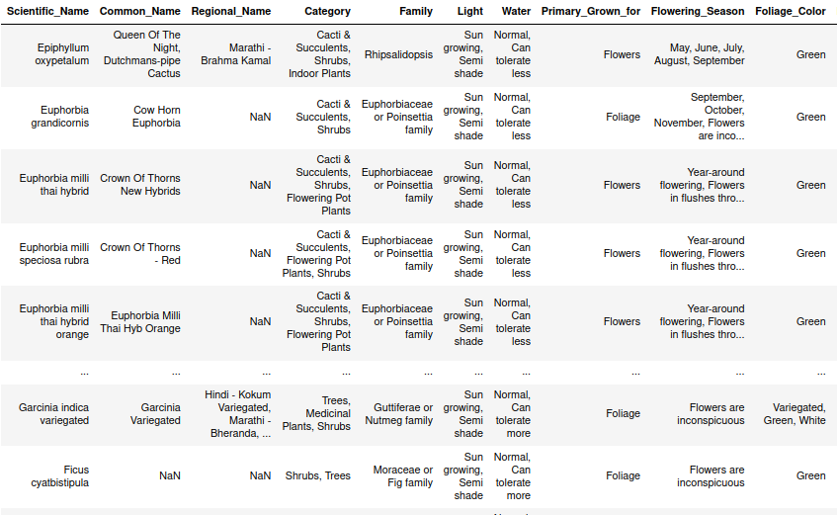
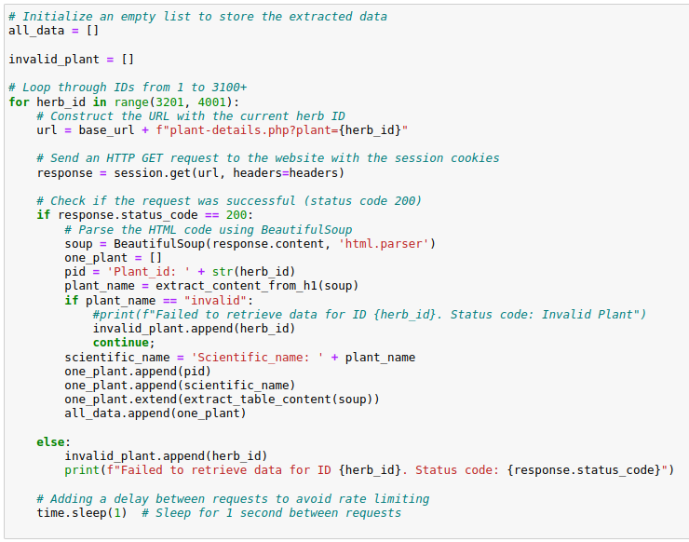
Scraping - Plant Data
Displayed is a snippet of data obtained by scraping the India Plant website with BeautifulSoup.

Slide 8
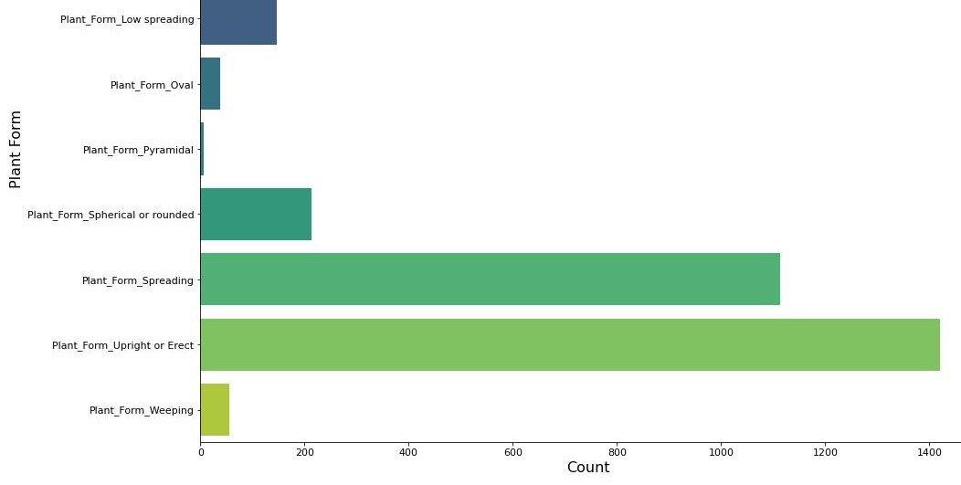
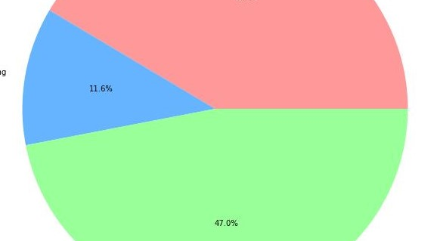
Data Preprocessing and EDA
Transformed categorical columns into one-hot encoding for efficient processing.
Utilized TF-IDF (Term Frequency-Inverse Document Frequency) on textual data for feature extraction and exploration.

Slide 9
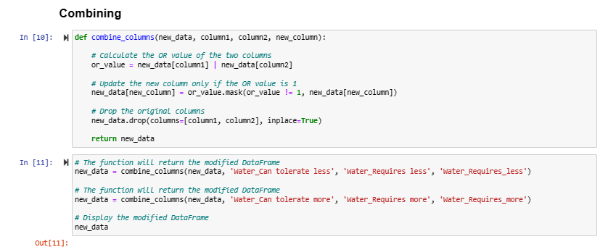
Data Preprocessing
Multi-Label Categorical Data :
We consolidated similar categorical columns and applied one-hot encoding to the entire categorical feature set.

Slide 10
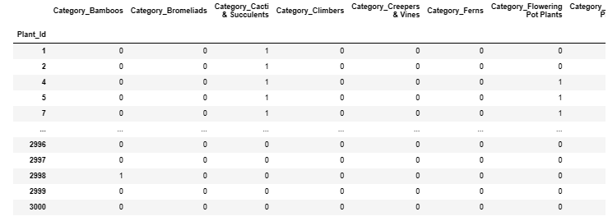
Vector representation of plants

Slide 11
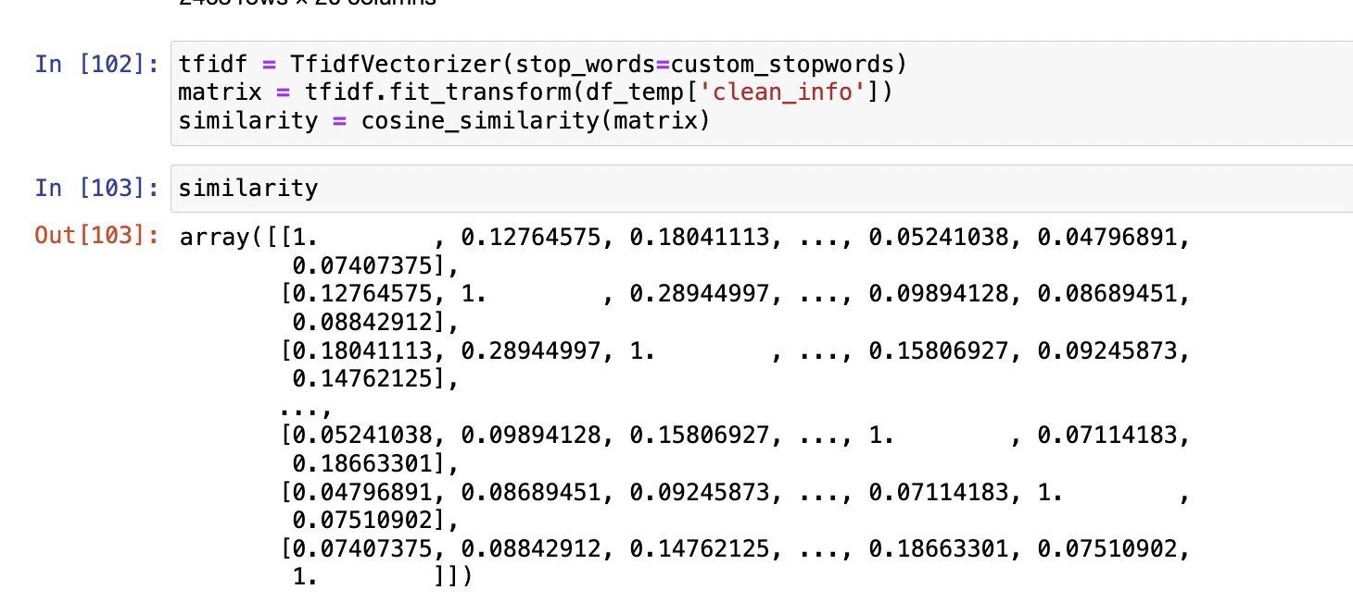
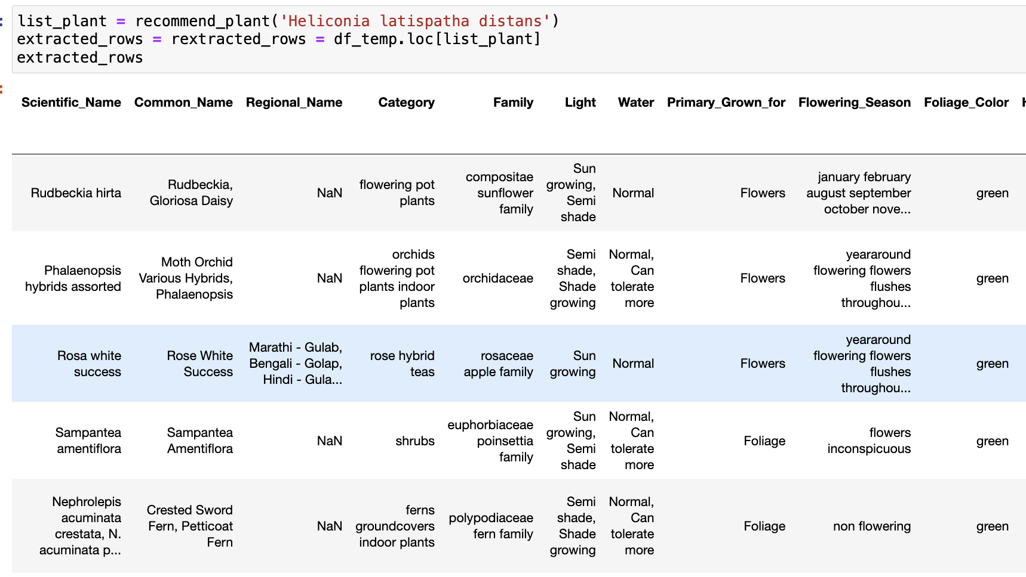
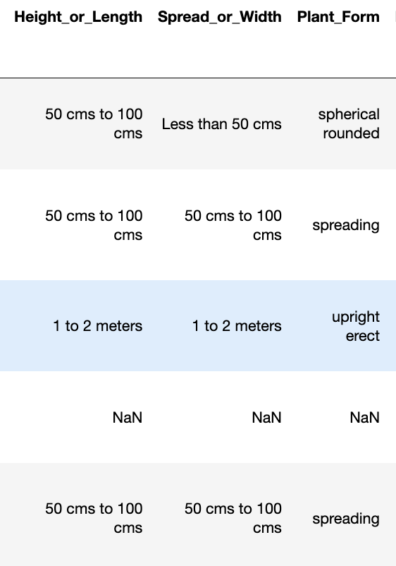
Data Preprocessing
Textual Data : Data Cleaning :
Tokenization
Stop word removal
Lemmatization
Plant vector generated using TF-IDF.

Slide 12
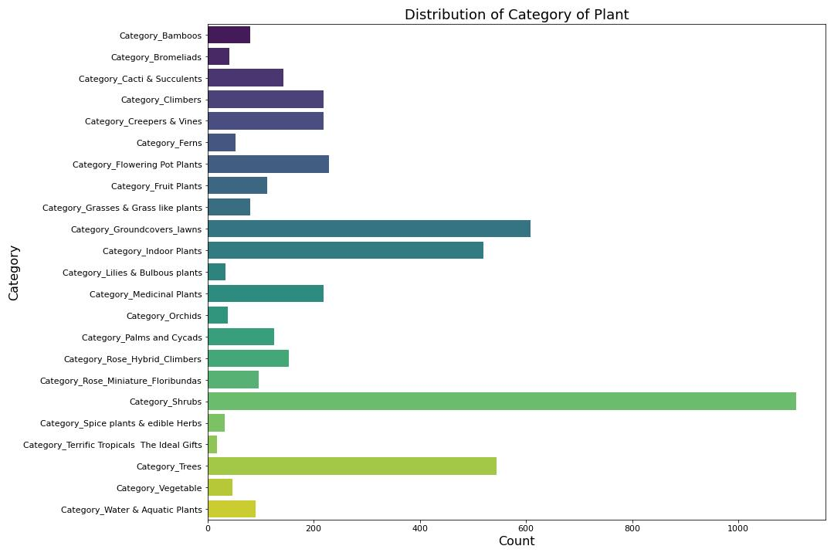
EDA

Slide 13
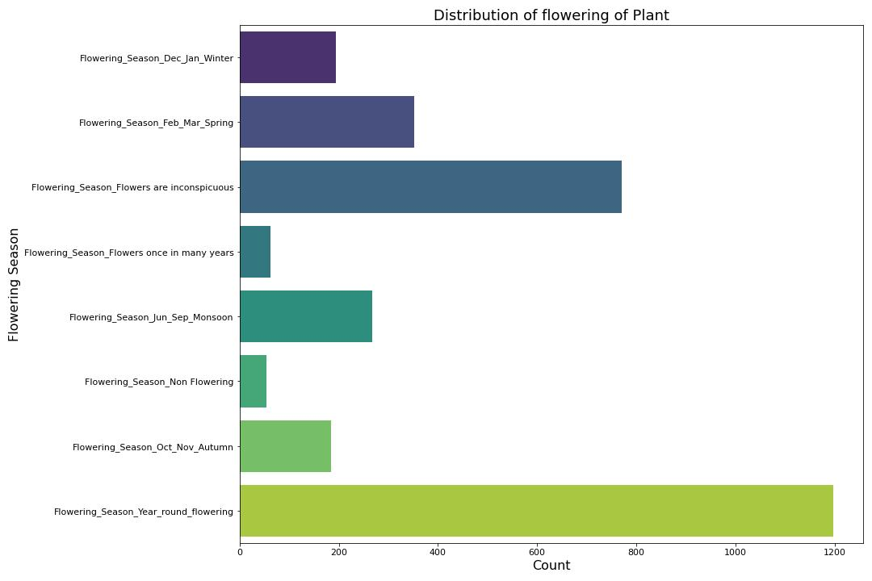
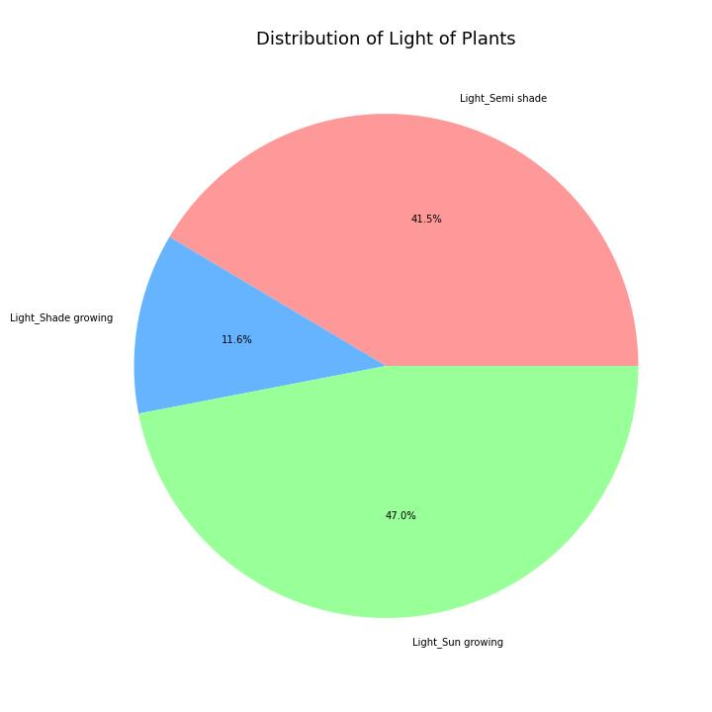

Slide 14
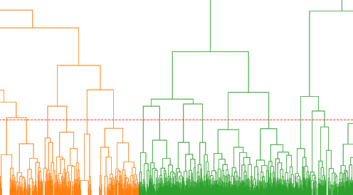
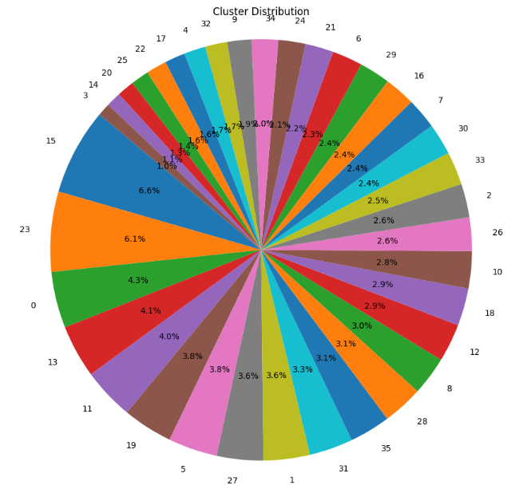
Algorithm Implementations
We've utilized Collaborative Filtering for plant recommendation, investigating diverse clustering algorithms
Additionally, for personalized recommendations, we've employed Content-Based Similarity using TF-IDF.

Slide 15
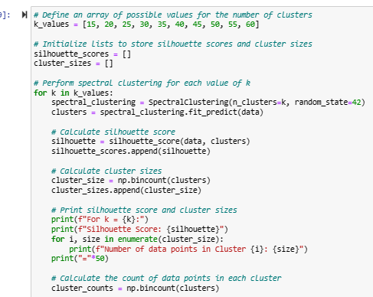
Spectral Clustering

Slide 16
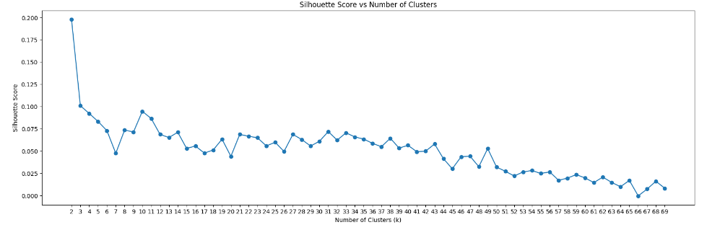

Slide 17
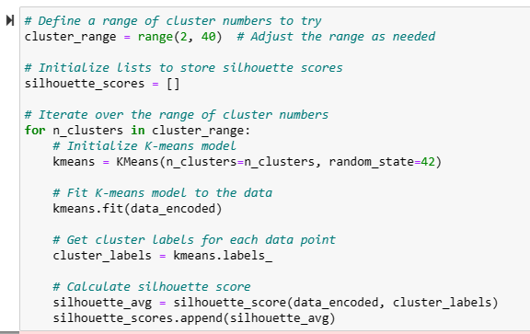
KMeans Clustering

Slide 18
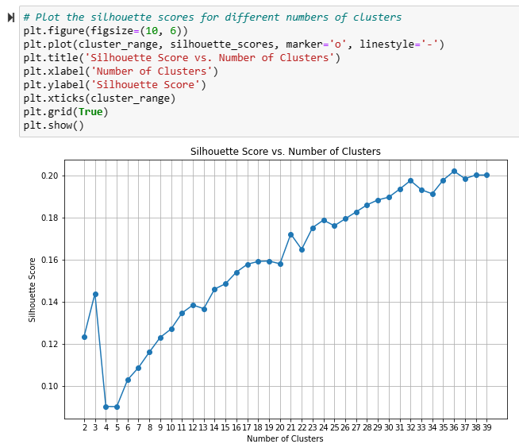
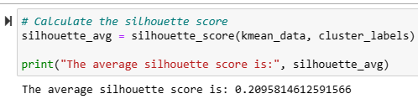
Optimal clusters were found to be 36 with an average silhouette score of 0.2095814612591566

Slide 19
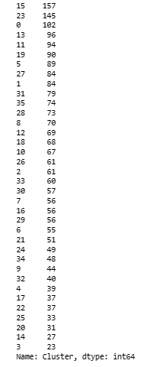

Slide 20
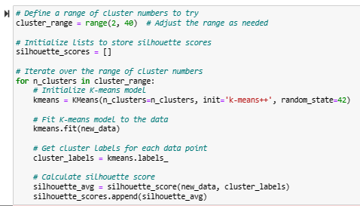
KMeans++ Clustering

Slide 21
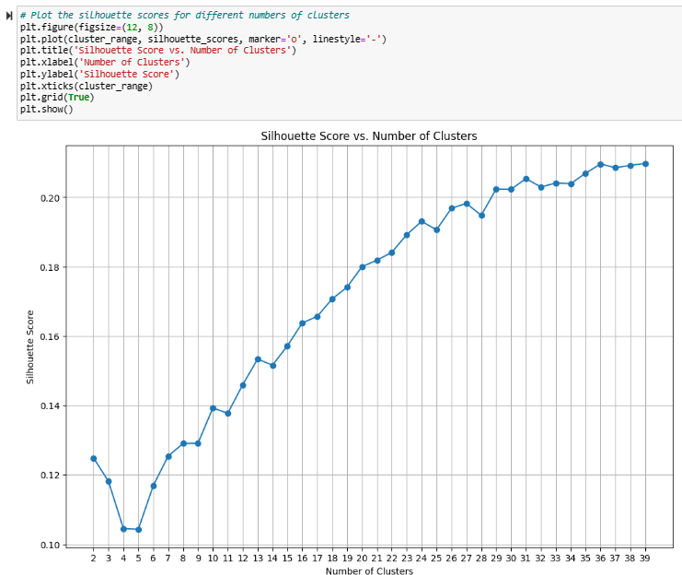
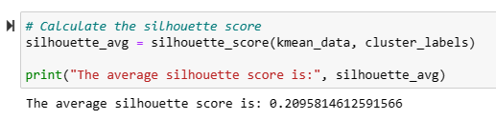
Optimal clusters were found to be 36 with an average silhouette score of 0.2095814612591566

Slide 22
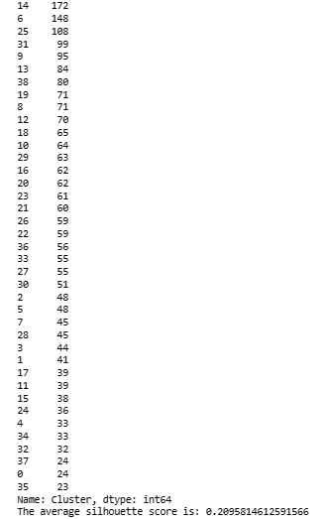
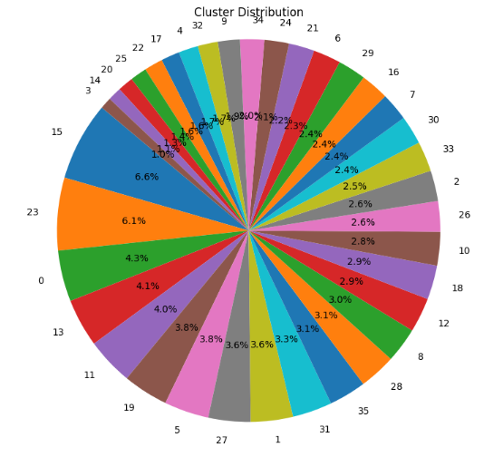

Slide 23
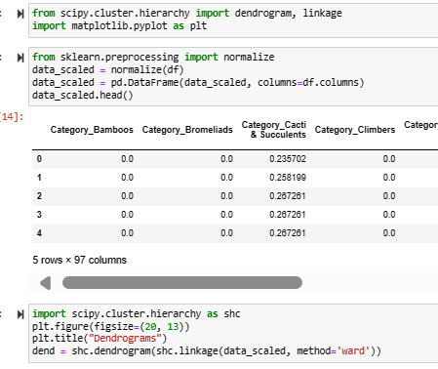
Hierarchical Clustering

Slide 24
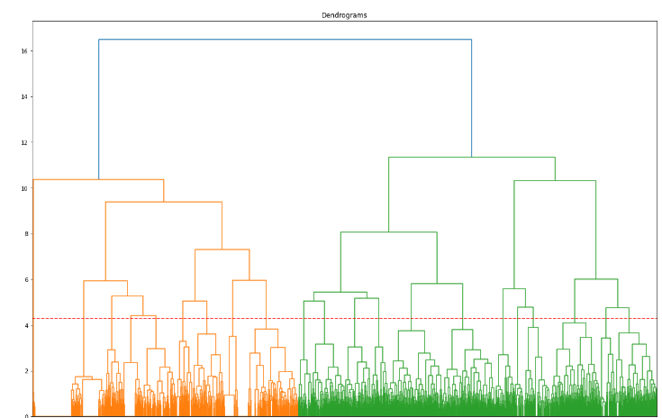
From Dendrogram we observe distinct clusters in the data at y = 4.3

Slide 25
Comparison
Spectral Clustering
KMeans and KMeans++ Clustering
Clustering distribution exhibited clustering imbalance, predominantly concentrating points in one cluster.
Optimal number of clusters : 36
Demonstrated a more favorable clustering distribution, with data points evenly distributed across multiple clusters.

Slide 26
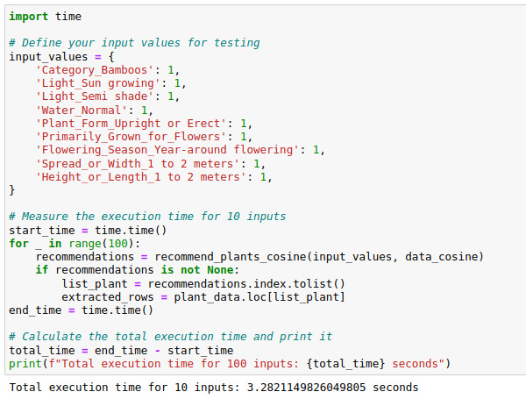
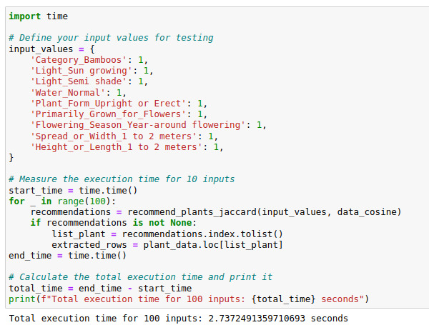
Similarity Metrics
Cosine Similarity
Jaccard Similarity

Slide 27
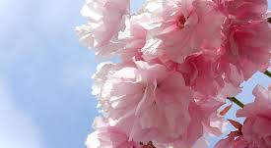
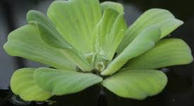
Recommendations
Plant Recommendation
Medicinal Plant Recommendation
Personalized Plant Recommendation

Slide 28
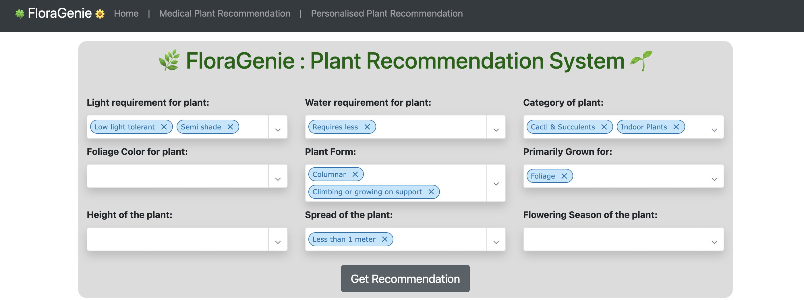
Application

Slide 29
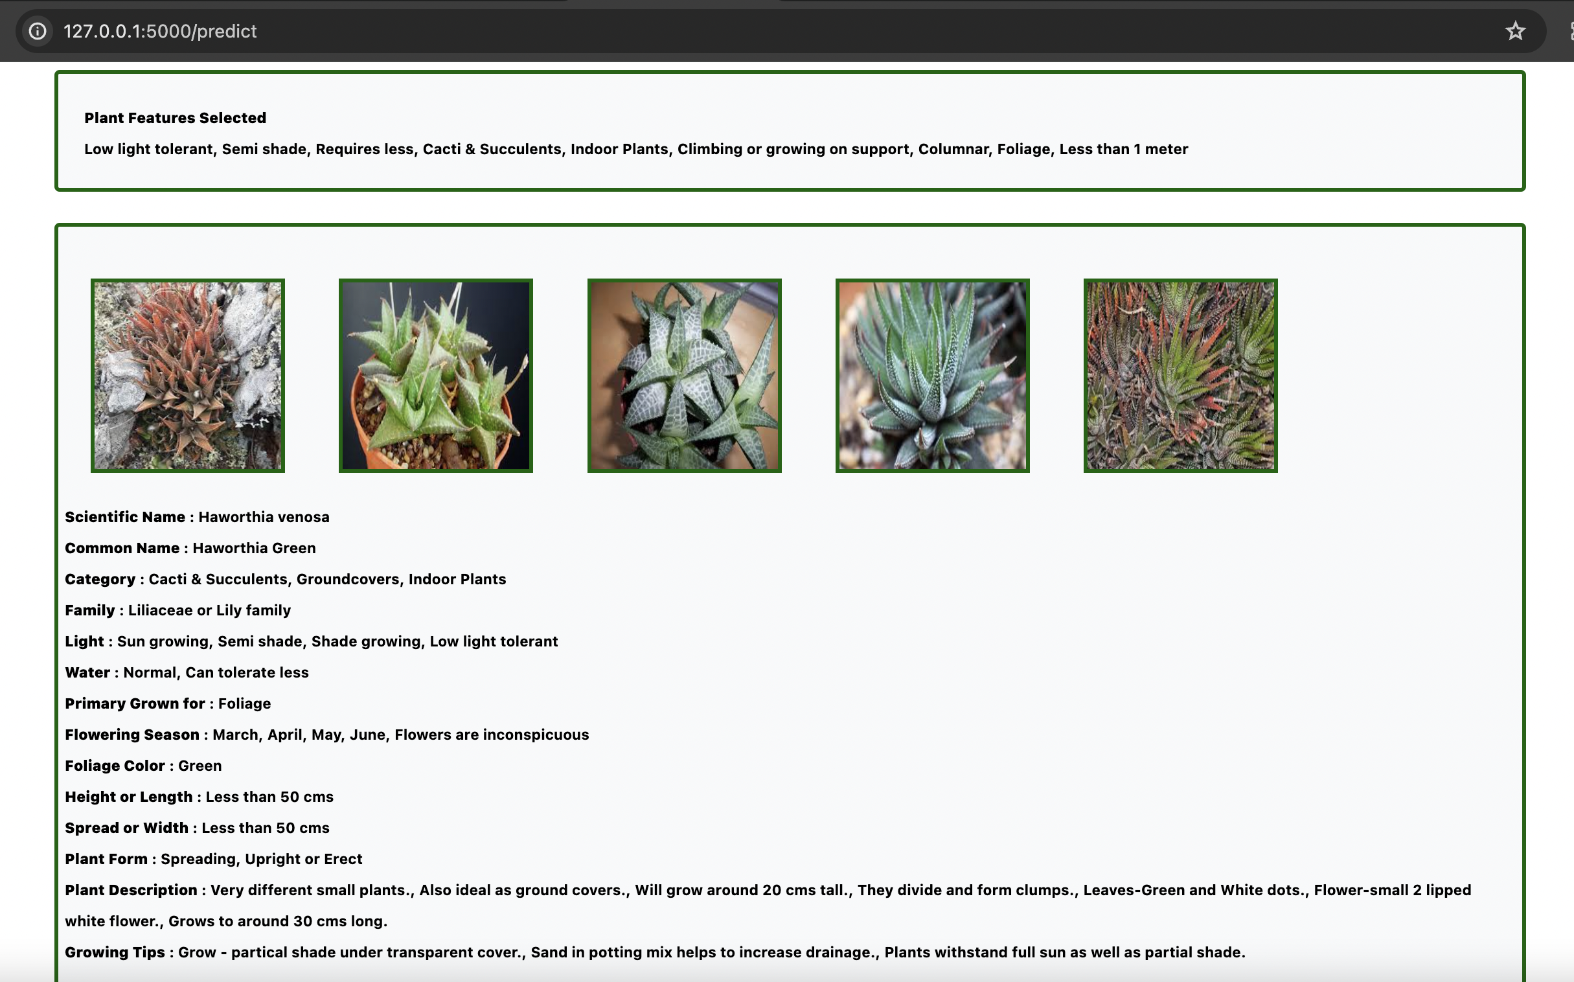

Slide 30
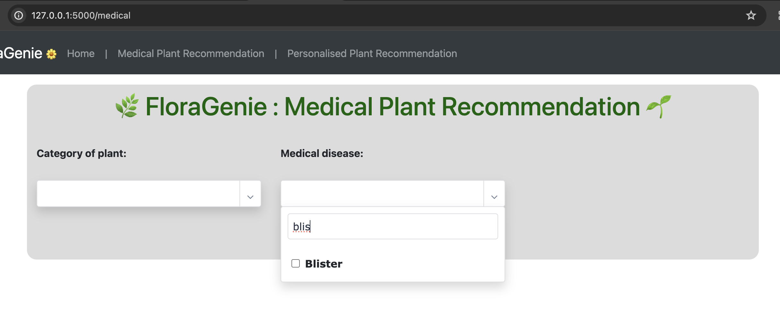
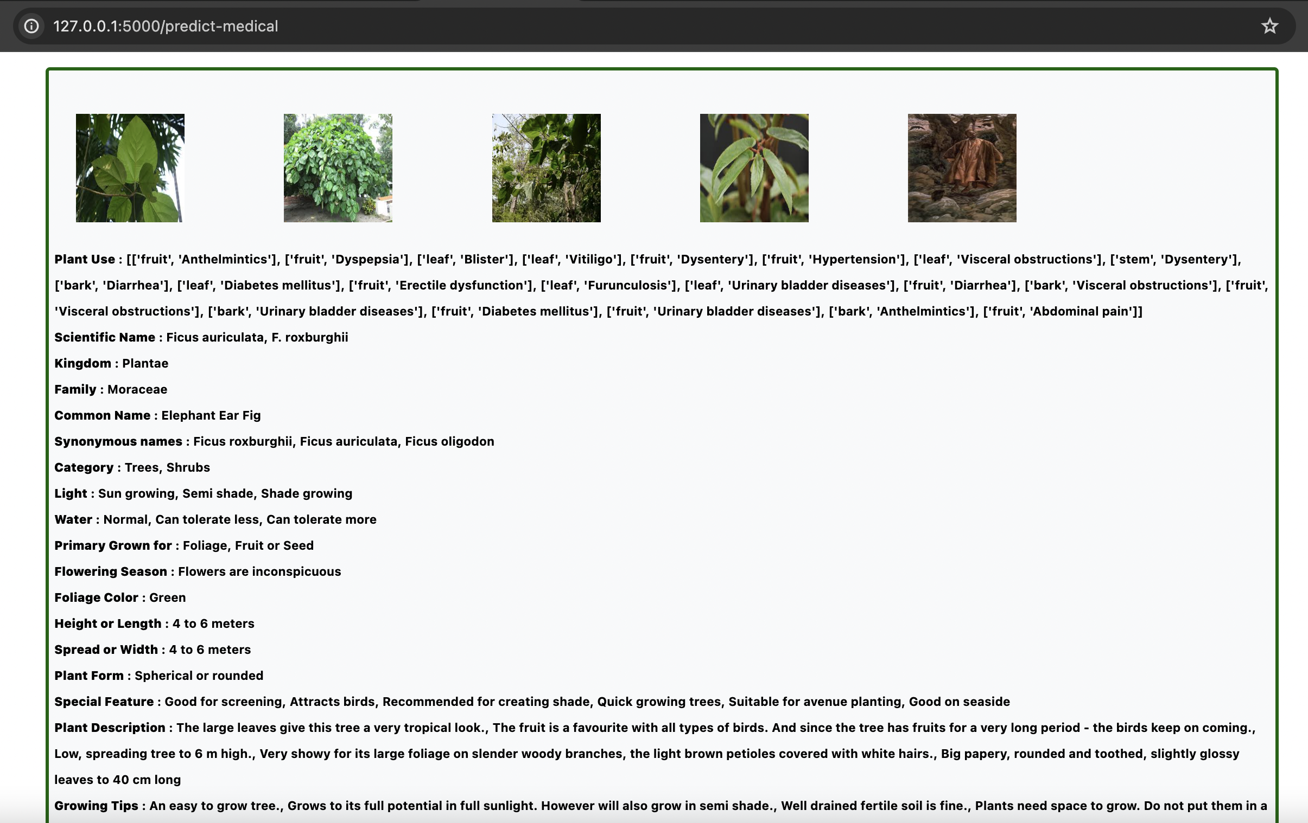

Slide 31
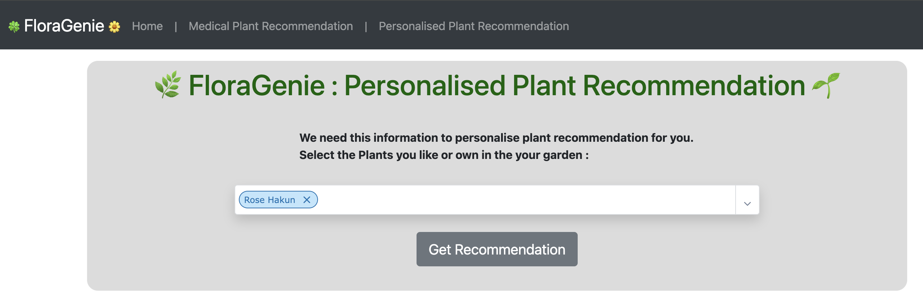
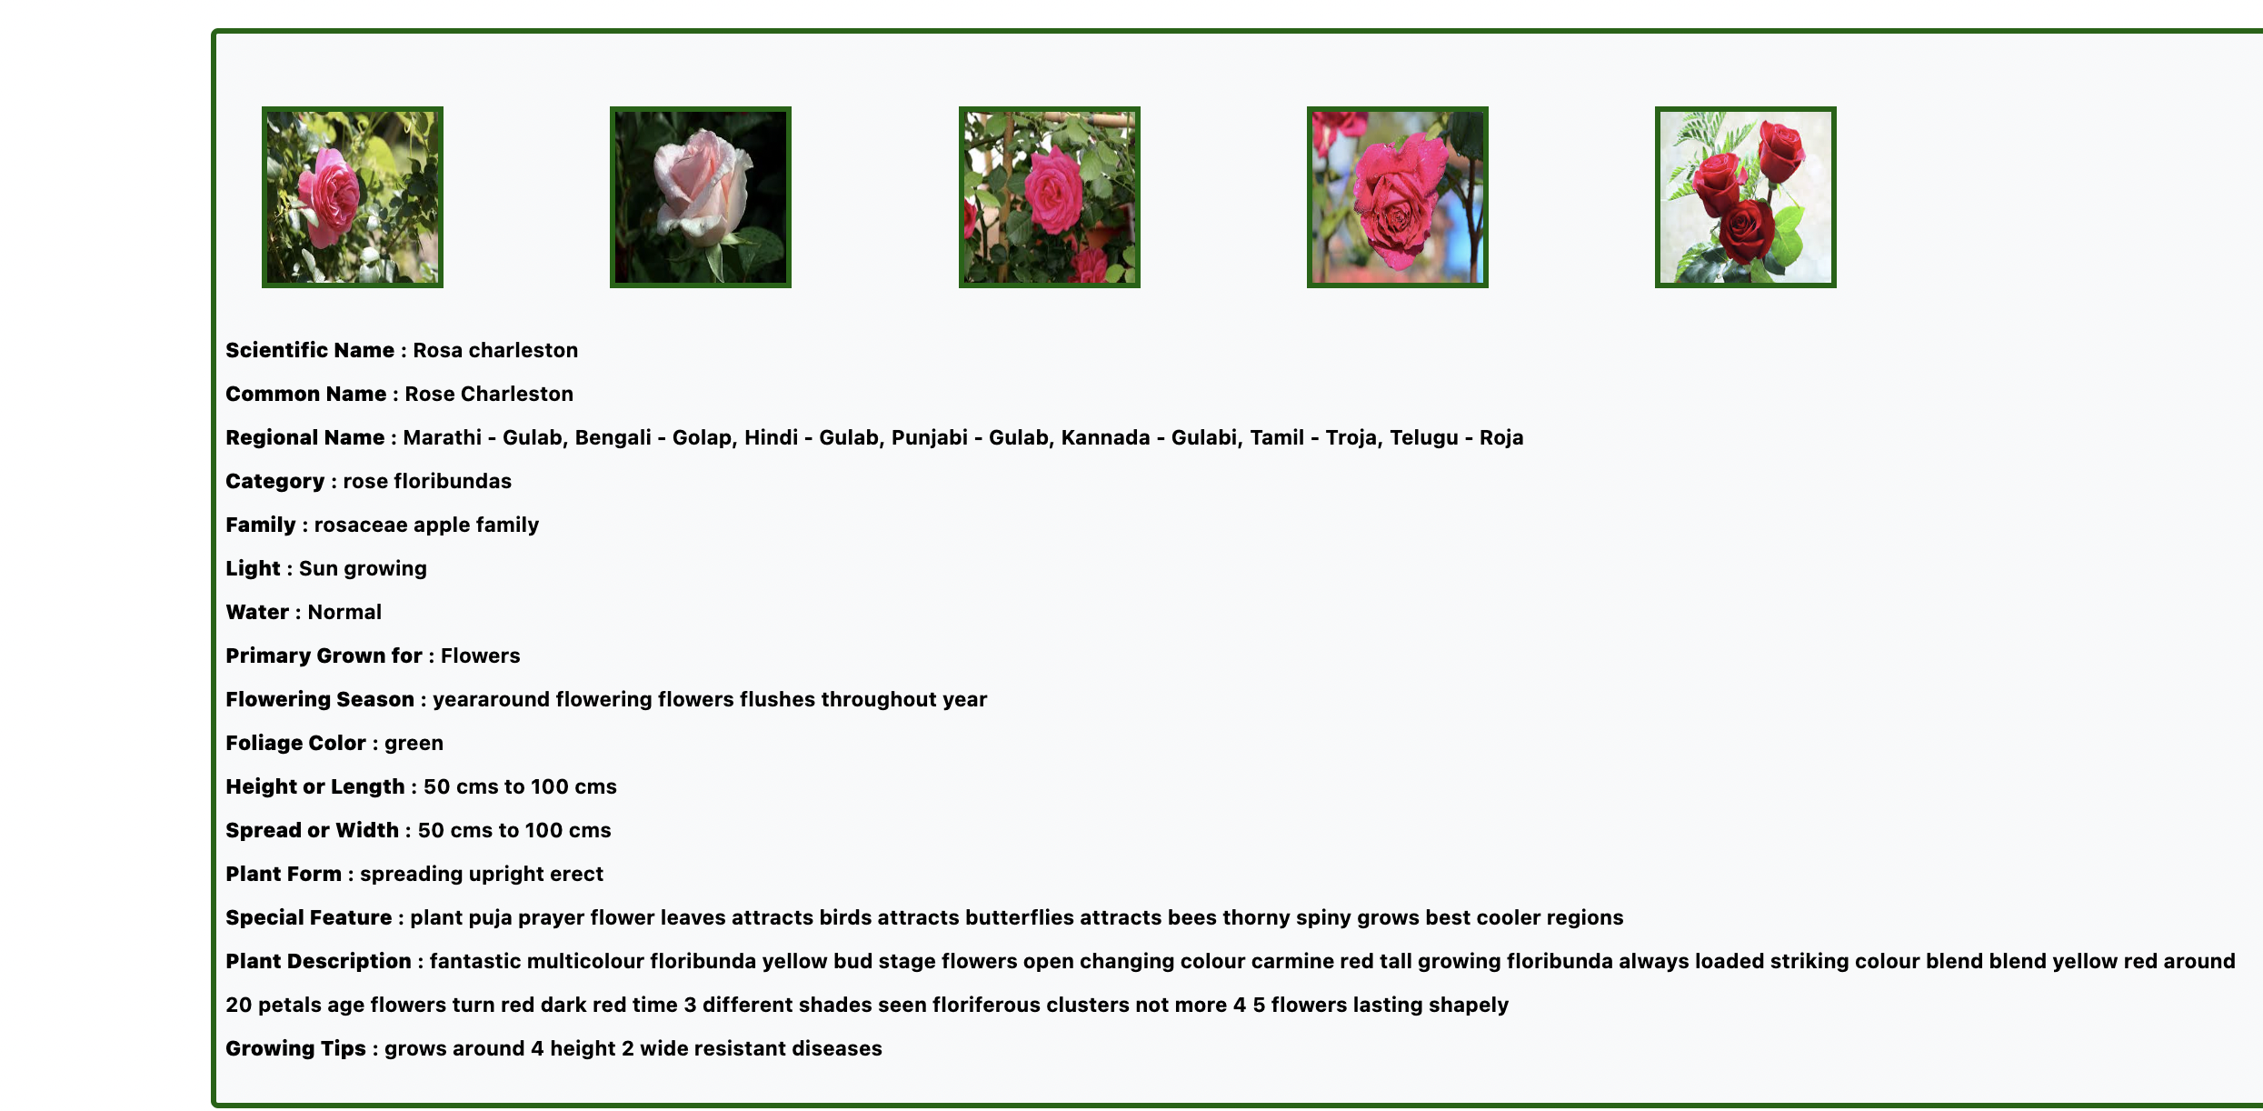

Slide 32
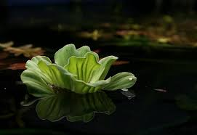
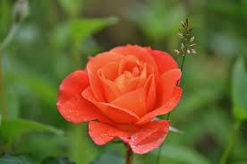
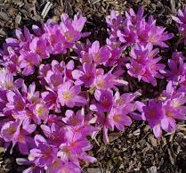
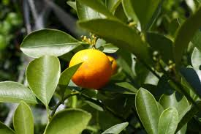
Future Works
Recommendations using word embeddings of plant information.
Exploring other similarity matrix for textual data and categorical data.

Slide 33
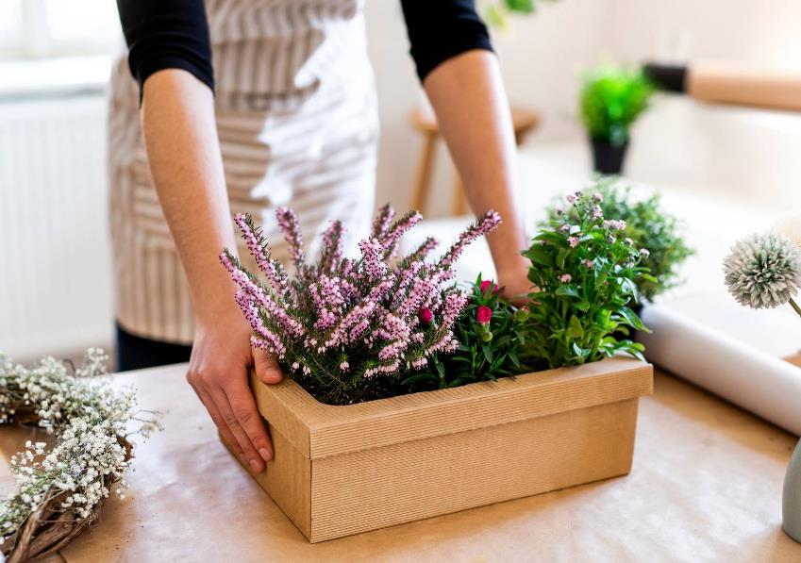
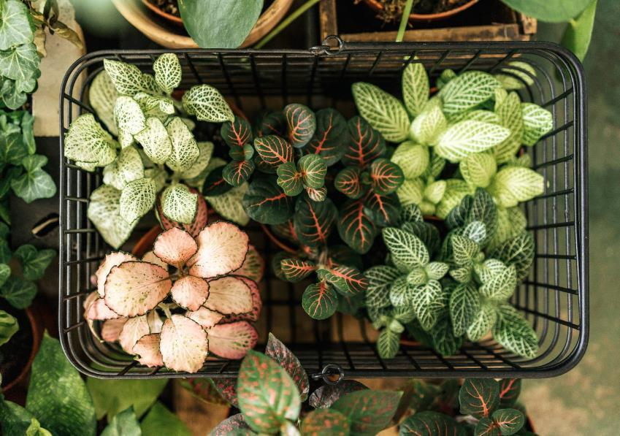
Thank you

